Slide 1






Dr. Babasaheb Ambedkar Technological University, Lonere
Dept. of
Electronics and Telecommunication Engineering
Under the guidance of
Miss. Mohini Mehta
Paper Presentation on:-
Pc Log-in Log-out using RFID Module
Presentation by –
Siddhesh B. Dangade PRN – (2130331372501) Diksha P. Kharvilkar PRN – (2130331372505)

Slide 2

Introduction

Slide 3
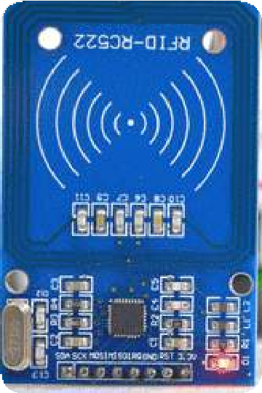
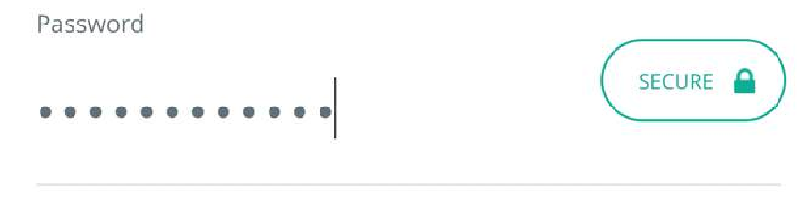

Introduction
This Project is about accessing the system with speed and confidentiality.
Arduino Uno and RFID module work together as one authentication system which unlocks system as soon as registered RFID card is placed in front of RFID module.
Speed and confidentiality is the main strength of this system, this is majorly designed for areas where lot of public is present.

Slide 4

About Arduino Uno

Slide 5



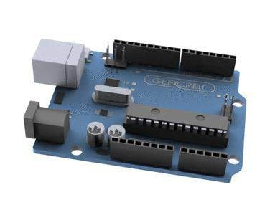

About Arduino Uno
ATmega328P
The high-performance, low-power AVR microcontroller.
Battery Connector
The Arduino UNO features a barrel plug connector, that works great
with a standard 9V battery.
EEPROM
The ATmega328P also features 1kb of EEPROM, a memory
which is not erased when powered off.
Replaceable chip
The ATmega328P can easily be replaced, as it is not soldered to the board.

Slide 6

Specification of Arduino UNO

Slide 7

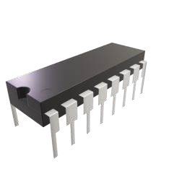




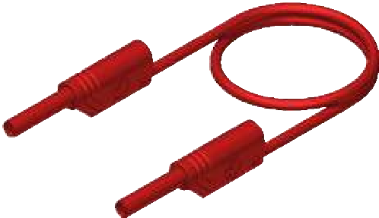





Specification of Arduino UNO
Microcontroller | ATmega328P – 8 bit AVR family microcontroller
Operating Voltage | 5V
Recommended Input Voltage | 7-12V
Input Voltage Limits | 6-20V
Analog Input Pins | 6 (A0 – A5)
Digital I/O Pins | 14 (Out of which 6 provide PWM output)
DC Current on I/O Pins | 40 mA
DC Current on 3.3V Pin | 50 mA
Flash Memory | 32 KB (0.5 KB is used for Bootloader)
SRAM | 2 KB
EEPROM | 1 KB
Frequency (Clock Speed) | 16 MHz

Slide 8

About RFID Module (RC522)

Slide 9
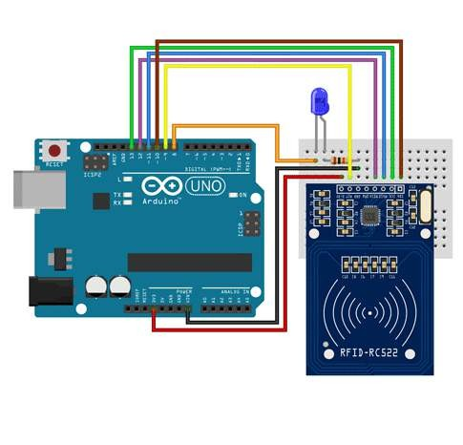
About RFID Module (RC522)
RC522 Features
13.56MHz RFID module
Operating voltage: 2.5V to 3.3V
Communication : SPI, I2C protocol, UART
Maximum Data Rate: 10Mbps
Read Range: 5cm
Current Consumption: 13-26mA
Power down mode consumption: 10uA (min)

Slide 10

Working of RFID Module

Slide 11

Working of RFID Module
When the tag is brought close to the reader, the reader generates an electromagnetic field. This causes electrons to move through the tag’s antenna and subsequently powers the chip.
The chip then responds by sending its stored information back to the reader in the form of another radio signal. This is called a backscatter. The reader detects and interprets this backscatter and sends the data to a computer or microcontroller.

Slide 12

Application of RC522

Slide 13

Application of RC522
Applications
Attendance systems
Verification/Identification system
Access control systems

Slide 14

Working of Project

Slide 15

Working of Project
When the tag is brought close to the reader, the reader detects the card. And then sends card report to Arduino Uno connected to it.
Arduino checks if the card scanned is authorized or not.
If yes then it blinks red led and enters password to windows which is connected to it and presses enter key.
When password is entered by Arduino which is stored in it’s memory ,pc unlocks.
If un-authorized card is scanned then white led glows and Arduino does not enters
password.

Slide 16

Connections

Slide 17
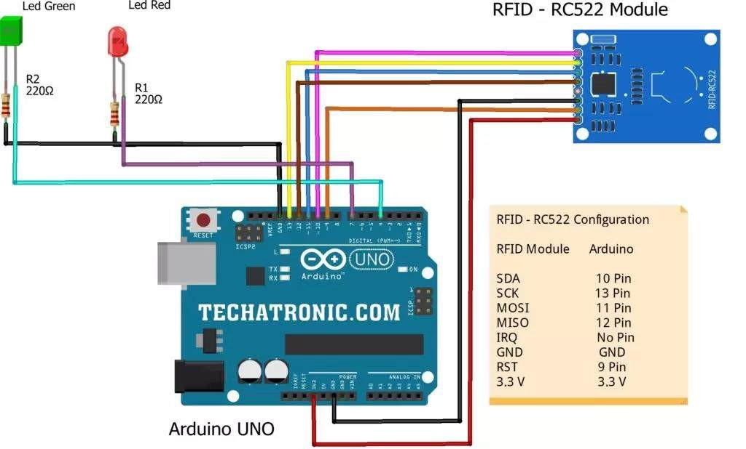
Connections
Connection Table
Arduino UNO | RFID – RC522 Module
10 Pin | SDA Pin
13 Pin | SCK Pin
11 Pin | MOSI Pin
12 Pin | MISO Pin
NO Pin | ITQ Pin
GND | GND
RST Pin | RST Pin
3.3 V Pin | 3.3 V
Arduino UNO | LED Green | LED Red | 220-ohm Resistor
4 Pin | Anode Pin
7 Pin |  | Anode Pin
GND |  |  | Terminal 1
 | Cathode Pin | Cathode Pin | Terminal 2

Slide 18

Advantages and Future Scopes

Slide 19
Advantages and Future Scopes
ADVANTAGES
Low Power Consumption
Easy To Setup
Low Cost
Fast And Responsive
Designed for quick and responsive system unlocking while consuming very low power,
easy to setup, low cost and easy to code.
Administrator log-in
Responsive System Unlocking
Accessing Confidential systems in public places.
Accessing security systems
Industrial system log-in

Slide 20

Conclusion

Slide 21

Conclusion
The ability to scan and unlock system quickly is main advantage of this project, there are many commercially available system unlocking tools like fingerprint , face-unlock , ultrasonic sensor etc. but all of these lack behind in speed. Although their speed is fast but can never be as fast as RFID scanning module because of processing and computation delay. This project requires very minimum computational power as well as very low energy. This enables for numerous implementations and applications.

Slide 22

References

Slide 23

References
Neerparaj Rai , “Arduino Projects for Engineers , 15 July 2016
Thomas Grace, Programming & Interfacing Atmel Avr Microcontrollers, 29 July 2015
Hervé Chabanne , Pascal Urien , Jean-Ferdinand Susini “RFID and the Internet of Things ,12 July 2013

